Slide 1



CMR TECHNICAL CAMPUS
UGC AUTONOMOUS
Accredited by NBA & NAAC with ‘A’ Grade
Approved by AICTE,New Delhi and affiliated to JNTU,Hyderabad Kandlakoya (V), Medchal Road, Hyderabad -501401, Telangana
Department of Computer Science and Engineering
Major Project Final Review
EFFICIENT EMAIL PHISHING DETECTION USING MACHINE LEARNING
BATCH NO-23
UNDER THE GUIDENCE OF : PRESENTED BY :
RAKSHITHA OKALI Anugna Lingampalli
(Assistant Professor) 207R1A0590

Slide 2

Abstract
Literature Survey
Existing System
Disadvantages of Existing System
Proposed System
Advantages of Proposed System
Hardware and software requirements
Novelty of the Project
Architecture

Slide 3
Modules
UML Diagrams
Sample Code
Results
Conclusion
Future Scope
References
Github Link

Slide 4

ABSTRACT
Emails are frequently utilized as a way of personal and professional communication. Banking information, credit reports, login data, and other sensitive personal information are commonly transmitted over email. This makes them valuable to cybercriminals, who can exploit the knowledge for their gain. Phishing is a technique used by con artists to steal sensitive information from people by impersonating well-known sources. The sender of a phished email can persuade you to disclose personal information under pretenses. The detection of a phished email is treated as a classification problem in this research, and this project shows how machine learning methods are used to categorize emails as phished or not. SVM classifier attains a maximum accuracy of 0.998 percent in email classification.

Slide 5
Literature Survey
PHISHING ENVIRONMENTS, TECHNIQUES, AND COUNTERMEASURES: A SURVEY
EXPLORING SUSCEPTIBILITY TO PHISHING IN THE WORKPLACE
INTELLIGENT DEEP MACHINE LEARNING CYBER PHISHING URL DETECTION BASED ON BERT FEATURES EXTRACTION
MACHINE LEARNING TECHNIQUES FOR DETECTION OF WEBSITE PHISHING: A REVIEW FOR PROMISES AND CHALLENGES
PHIBOOST – A NOVAL PHISHING DETECTION MODEL USING ADAPTIVE BOOSTING APPROACH

Slide 6

EXISTING SYSTEM
For identifying legal and fraudulent web pages, is based phishing detection systems use two lists: white lists and black lists.
The authors classified phishing websites using URL parameters such as length, number of unique characters, directory, domain name, and file name to identify them.
The system uses support Vector Machines to classify websites that are not online.
The system using harmony search and support vector machine meta-heuristic techniques.

Slide 7
Disadvantages of Existing system
An existing system not implemented an effective ML Classifiers like SVM,RF,NB.
An existing system not implemented for large number of datasets.

Slide 8

Proposed System
Implementing a system requires expertise in machine learning, Cyber security, and software engineering. Additionally, staying updated with the latest phishing tactics and security measures is crucial for maintaining the system's effectiveness.
Detecting email phishing efficiently using machine learning involves several steps and considerations.
Data Collection
Data Pre-processing
Training Data using Algorithms
Testing the Data
Finding the Results

Slide 9
Advantages of Proposed System
SVM is a supervised technique often used for text categorization because of its speed and accuracy. It generates a hyper plane, a two-dimensional line that best separates the categories, based on the training data. The decision boundary is the name given to this hyper plane
The naive Bayes classifier is a probabilistic technique that uses the Bayes theorem to classify sample data.

Slide 10
HARDWARE & SOFTWARE REQUIREMENTS
Hardware Requirements
Software Requirements
Processor - Pentium –IV
RAM - 4 GB (min)
Hard Disk - 20 GB
Key Board - Standard Windows Keyboard
Mouse - Two or Three Button Mouse
Monitor - SVGA
Operating system : Windows 7 Ultimate.
Coding Language : Python.
Front-End : Python.
Back-End : Django-ORM
Designing : HTML, CSS, JavaScript.
Data Base : MySQL (WAMP Server).

Slide 11
Novelty of the Project
Emails are frequently utilized as a way of personal and professional communication. Banking information, credit reports, login data, and other sensitive and personal information are frequently transmitted over email. This makes them valuable to cyber criminals, who can exploit the knowledge for their own gain. Phishing is a technique used by con artists to steal sensitive information from people by impersonating well-known sources. The sender of a phished email can persuade you to disclose personal information under false pretenses. The detection of a phished email is treated as a classification problem in this research, and this project shows how machine learning methods are used to categorize emails as phished or not. LMT classifiers attain a maximum accuracy in email classification.

Slide 12
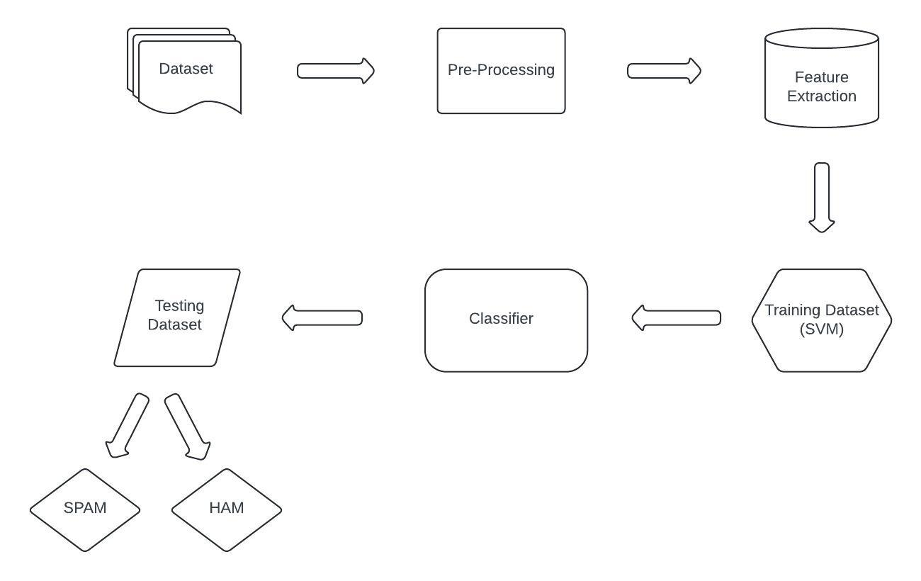
Architecture

Slide 13
Modules
Service Provider
In this module, the Service Provider has to login by using valid user name and password. After login successful he/she can do some operations such as
Login
Browse E-Mail Data Sets and Train & Test
View Trained and Tested Accuracy Results
Find E-Mail Phishing Detection Type Ratio and view ratio results
Download Predicted Data Sets

Slide 14
REMOTE USER In this module, there are n numbers of users are present. User should register before doing any operations. Once user registers, their details will be stored to the database. After registration successful, he/she has to login by using authorized user’s name and password. Once Login is successful user will do some operations like, Register and Login Predict Email Phishing Detection Type View your Profile.
VIEW AND AUTHORIZE USERS
In this module, the admin can view the list of users who all registered. In this, the admin can view the user’s details such as,
User name
Email
Address
Admin authorizes the users

Slide 15
UML DIAGRAMS Use Case Diagram

Slide 16
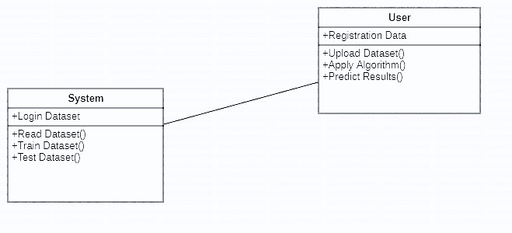
Class Diagram

Slide 17
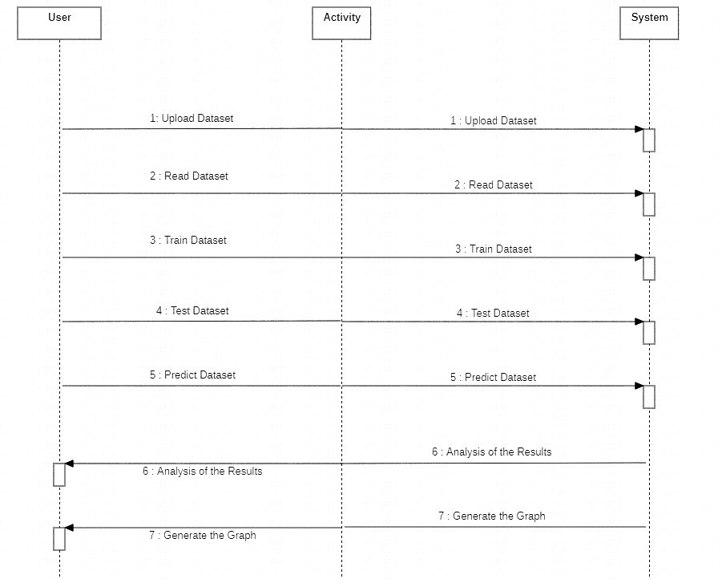
Sequence Diagram

Slide 18
Activity Diagram

Slide 19
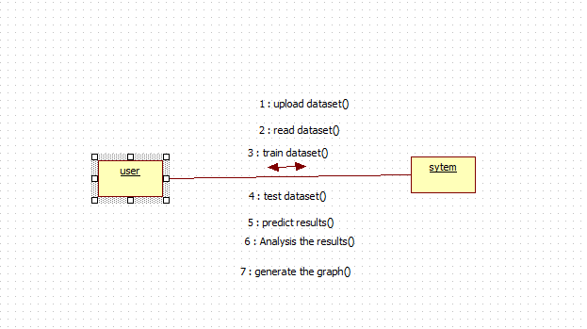
Collaboration Diagram

Slide 20
Deployment Diagram

Slide 21

Sample Code

Slide 22
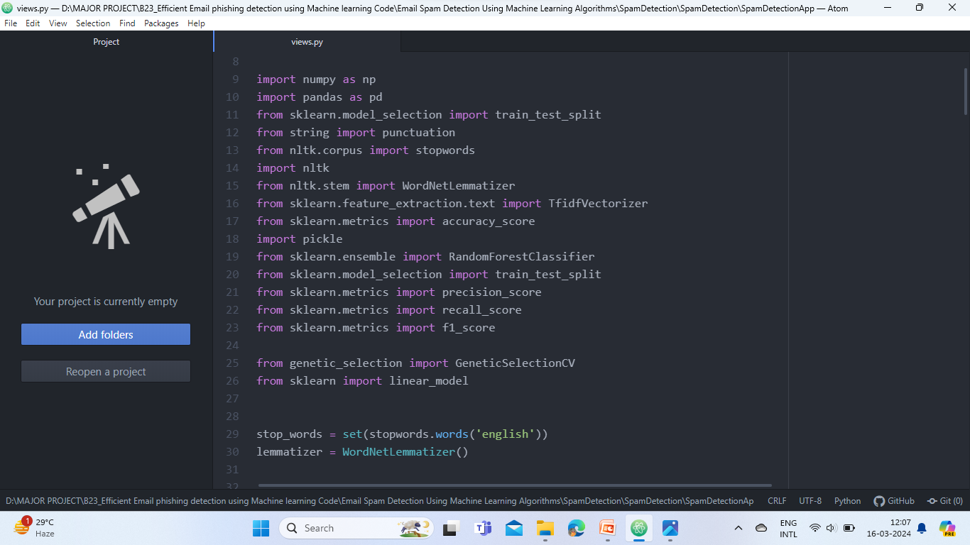

Slide 23
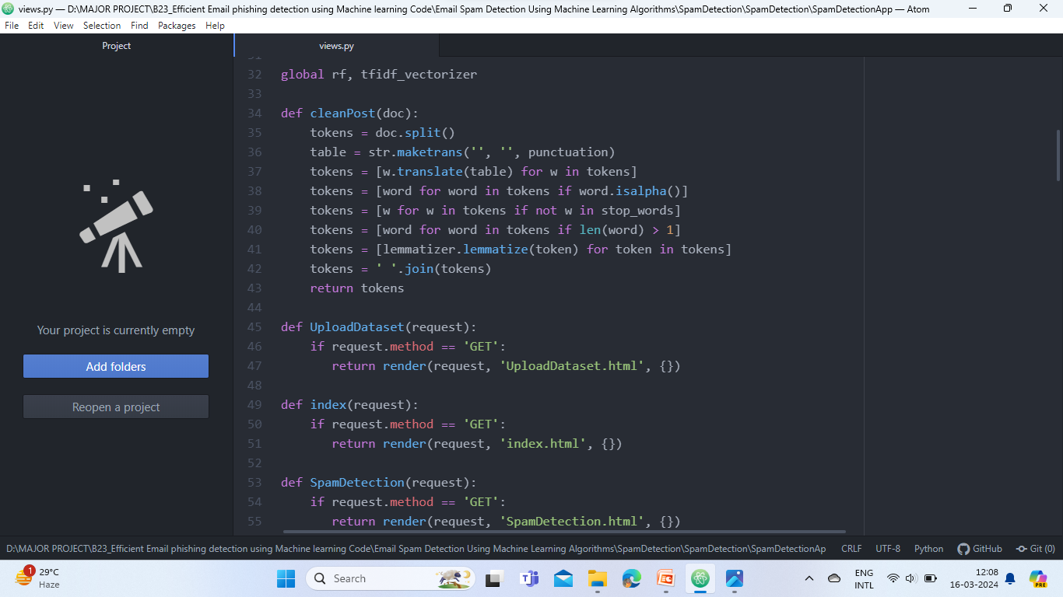

Slide 24
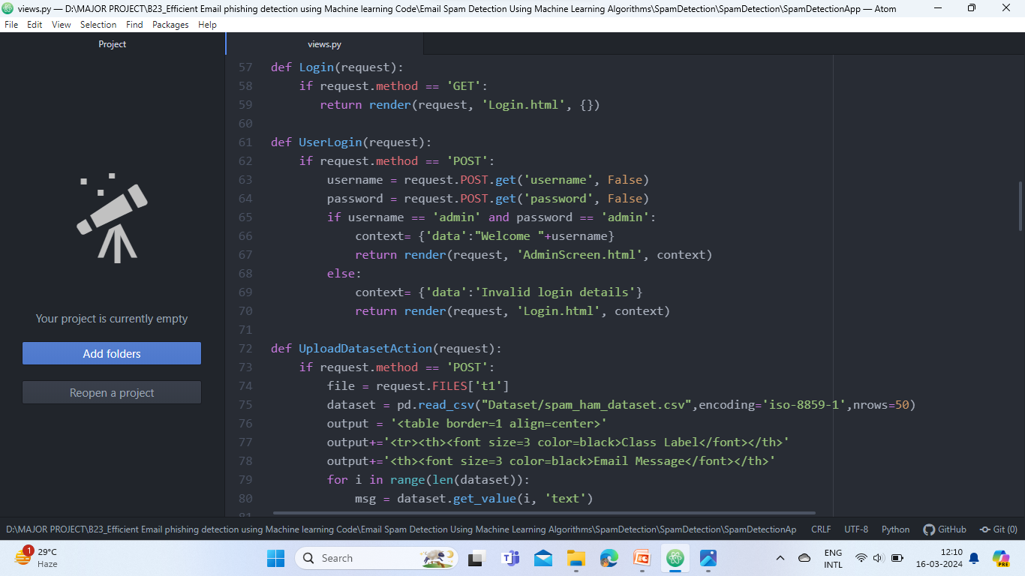

Slide 25
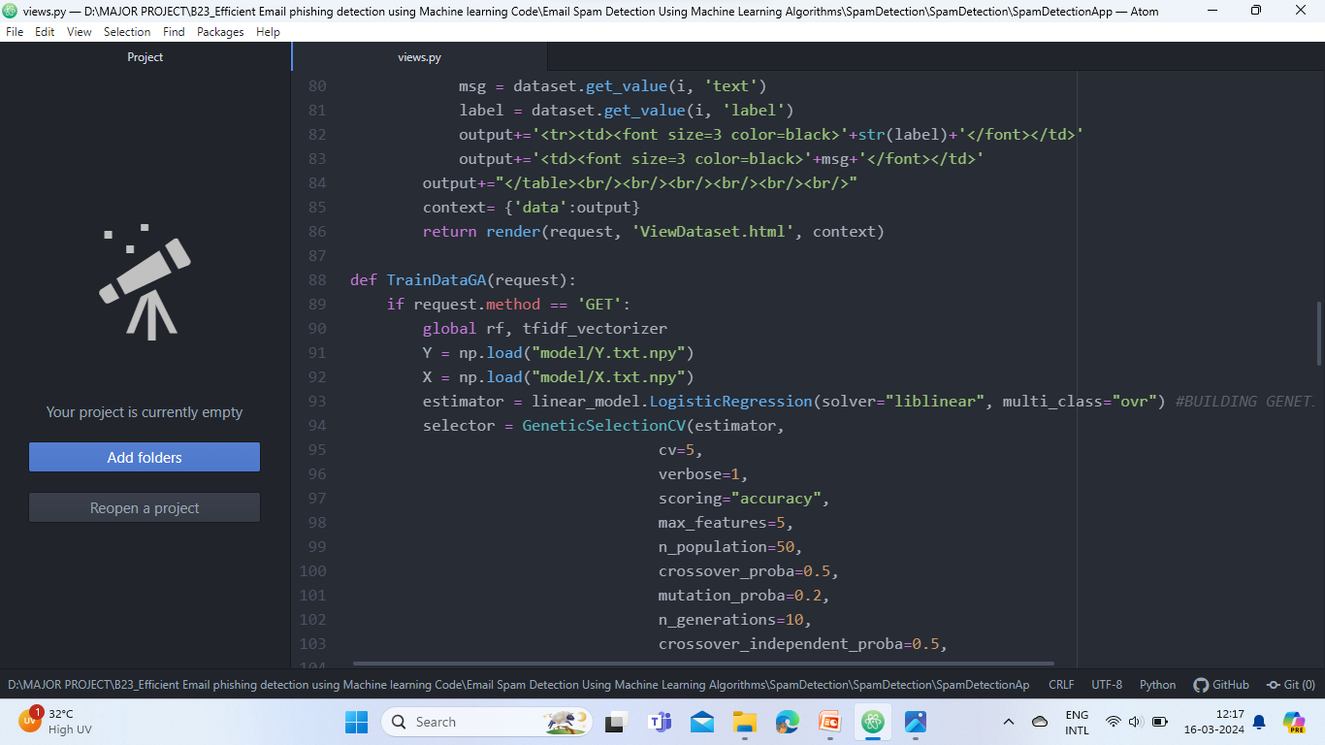

Slide 26
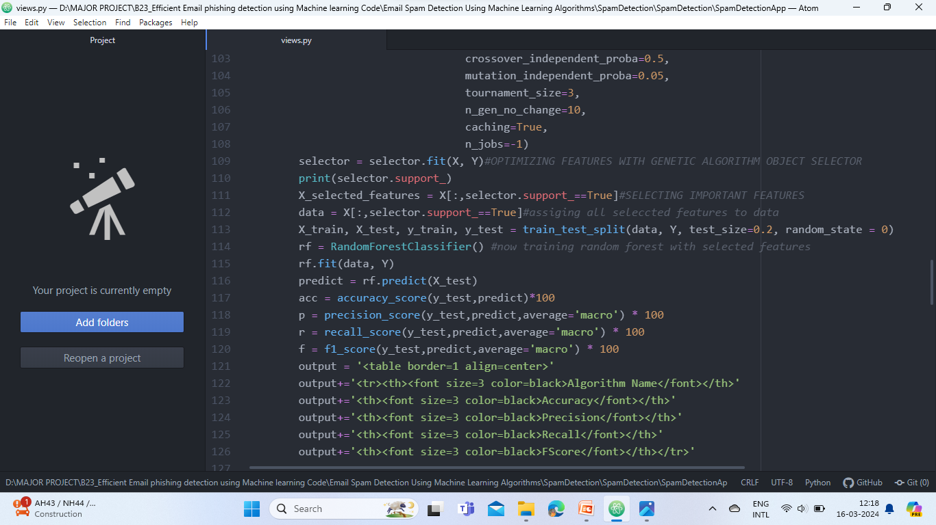

Slide 27
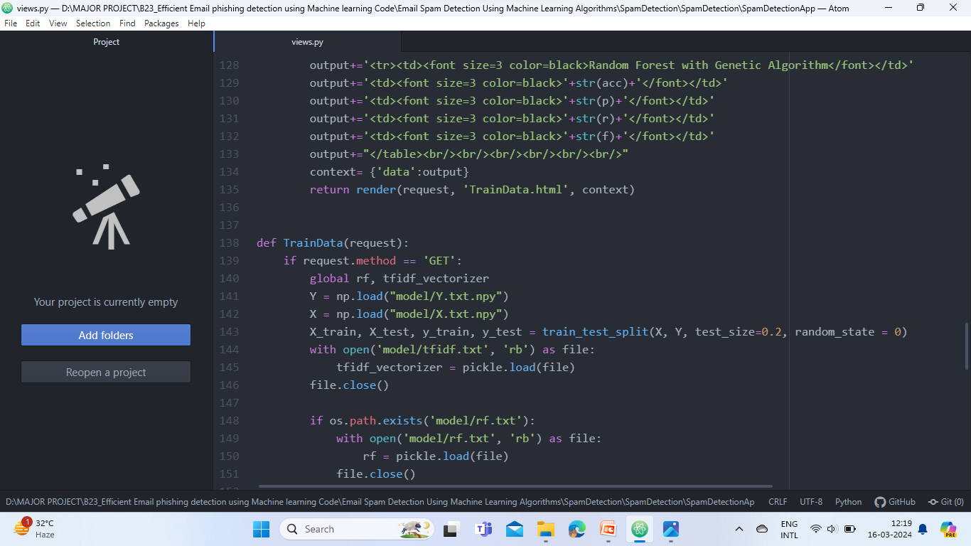

Slide 28
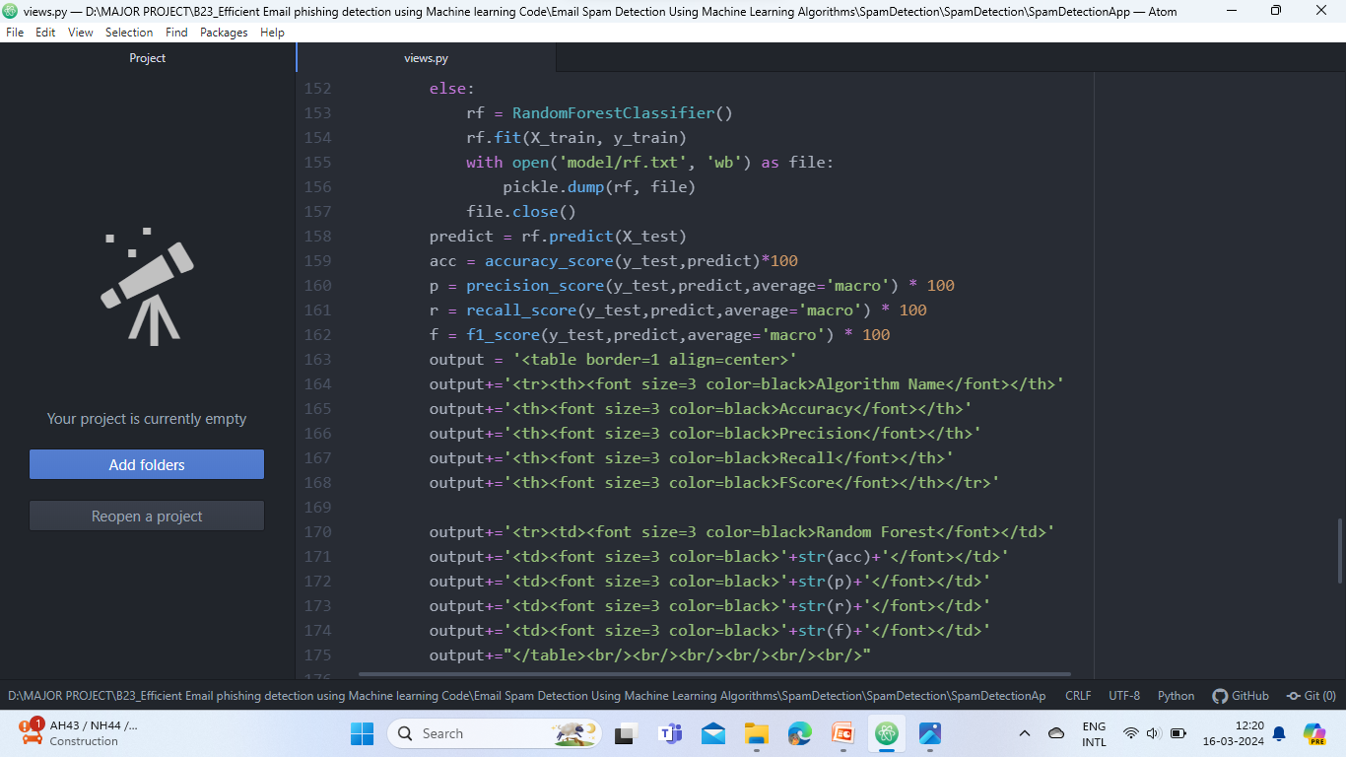

Slide 29
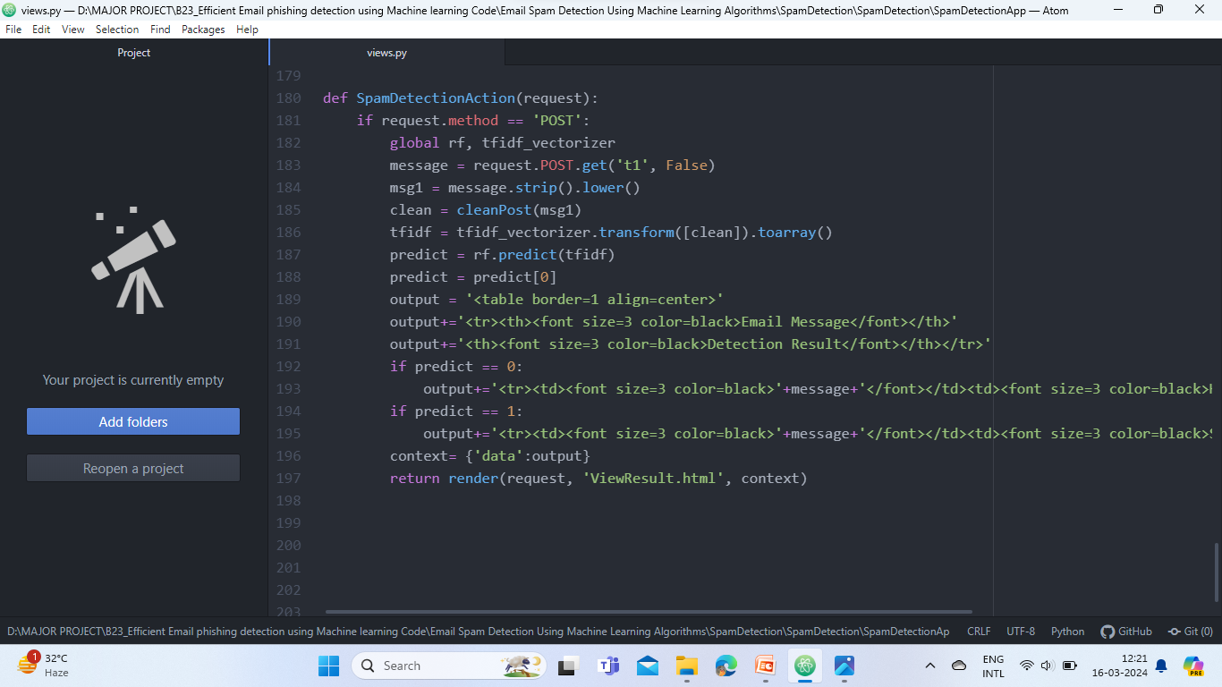

Slide 30
RESULTS
Random forest classifier is a machine learning algorithm used to classify applications as either phishing or non-phishing.
Random forest is known for its high accuracy and is used for phishing detection, as it works well with large datasets and can handle non linear relationships between features

Slide 31
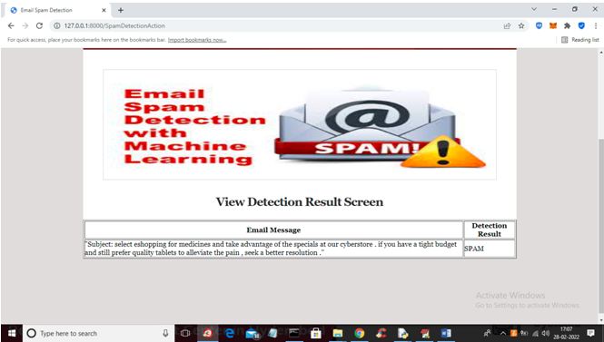
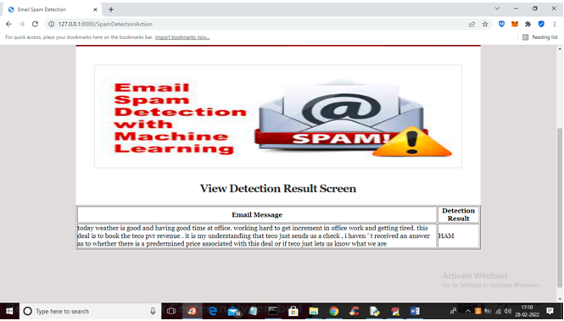
Output Results

Slide 32
Conclusion
The utilization of machine learning for efficient email phishing detection represents a significant stride in enhancing Cyber Security measures. The evolving sophistication of phishing attacks necessitates advanced and adaptive solutions, and machine learning provides a robust framework for achieving this . The effectiveness of machine learning in email phishing detection lies in its ability to discern subtle anomalies that may elude traditional rule-based systems. By leveraging historical data and continuously learning from new examples, machine learning models can accurately distinguish between legitimate and malicious emails, reducing false positives and enhancing overall detection accuracy.
Furthermore, the real-time nature of machine learning allows for quick response and mitigation, minimizing the potential impact of phishing attacks. Integrating machine learning into email security systems not only enhances the efficiency of threat detection but also reduces the burden on end-users, as automated systems can handle a significant portion of the analysis.

Slide 33
Future Scope
Future work focuses on Spreading sufficient awareness to detect phishing e-mail and increasing the security of companies or institutions to their users by reducing the risk of threats using highly accurate machine learning algorithms. I hope that the algorithm will be used in real life by all segments of society, allowing them to benefit from it and raise their awareness of the dangers that individuals face in society.
Feature selection techniques need more improvement to cope with the continuous development of new techniques by the attackers over the time. Therefore, we recommend developing a new automated tool in order to extract new features from new raw emails to improve the accuracy of detecting phishing email and to cope with the expanding with attacker techniques.

Slide 34
References
[1] A. Aleroud and L. Zhou (2018), "Phishing environments, techniques, and countermeasures: A survey," Computers & Security, vol. 68, pp. 160-196, 2017.
[2] I. Vayansky and S. Kumar (2018), "Phishing–challenges and solutions," Computer Fraud & Security, vol. 2018, pp. 15-20.
[3] Ammar Odeh, (2021), "Machine Learning Techniques for Detection of Website Phishing: A Review for Promises and Challenges," in 2021 IEEE 11th Annual Computing and Communication Workshop and Conference (CCWC), pp. 0813-0818.
[4] A. Odeh, (2021), "PHIBOOST-a novel phishing detection model using Adaptive boosting approach,"Jordanian Journal of Computers and Information Technology (JJCIT), vol. 7.

Slide 35
GITHUB LINK
https://github.com/Anu-Lingampalli/Email-Phishing-Detection

Slide 36

.
.

